Slide 1

Level A
© 2015 AT&T Intellectual Property. All rights reserved. AT&T and the AT&T logo are trademarks of AT&T Intellectual Property.
AT&T Proprietary (Internal Use Only) Not for use or disclosure outside the AT&T companies except under written agreement

Slide 2
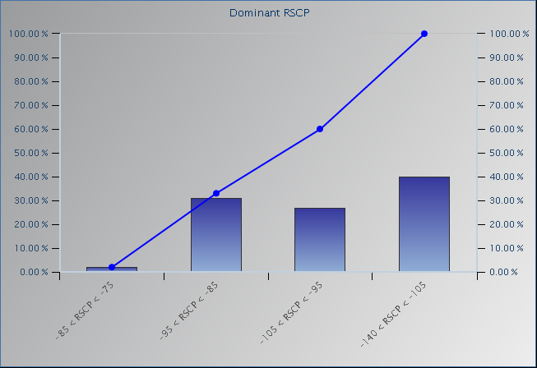
UMTS 850 Scan – UARFCN 4358 Ec (RSCP) Histogram
RSCP
-140 to -105
-105 to -95
-95 to -85
-85 to -75
-75 to -65
-65 to -30
© 2015 AT&T Intellectual Property. All rights reserved. AT&T and the AT&T logo are trademarks of AT&T Intellectual Property.
AT&T Proprietary (Internal Use Only) Not for use or disclosure outside the AT&T companies except under written agreement

Slide 3
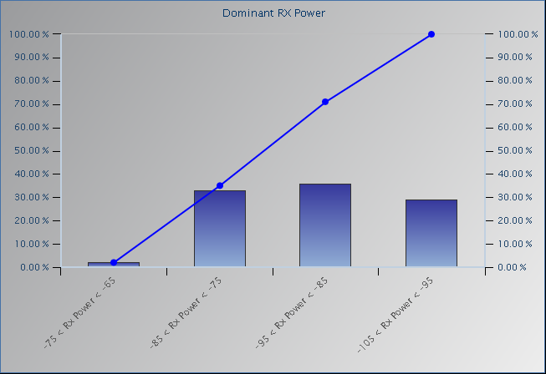
UMTS 850 Scan – UARFCN 4358 Io (RSSI) Histogram
RX Power
-140 to -105
-105 to -95
-95 to -85
-85 to -75
-75 to -65
-65 to -30
© 2015 AT&T Intellectual Property. All rights reserved. AT&T and the AT&T logo are trademarks of AT&T Intellectual Property.
AT&T Proprietary (Internal Use Only) Not for use or disclosure outside the AT&T companies except under written agreement

Slide 4
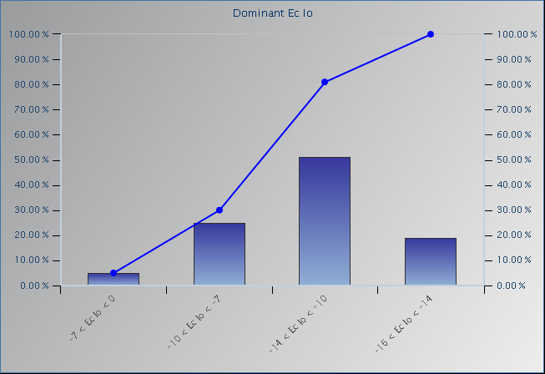
UMTS 850 Scan – UARFCN 4358 Ec/Io Histogram
Ec Io
-16 to -14
-14 to -10
-10 to -7
-7 to 0
0 to -16
© 2015 AT&T Intellectual Property. All rights reserved. AT&T and the AT&T logo are trademarks of AT&T Intellectual Property.
AT&T Proprietary (Internal Use Only) Not for use or disclosure outside the AT&T companies except under written agreement

Slide 5
UMTS 850 Scan – UARFCN 4383 Ec (RSCP) Histogram
RSCP
-140 to -105
-105 to -95
-95 to -85
-85 to -75
-75 to -65
-65 to -30
© 2015 AT&T Intellectual Property. All rights reserved. AT&T and the AT&T logo are trademarks of AT&T Intellectual Property.
AT&T Proprietary (Internal Use Only) Not for use or disclosure outside the AT&T companies except under written agreement

Slide 6
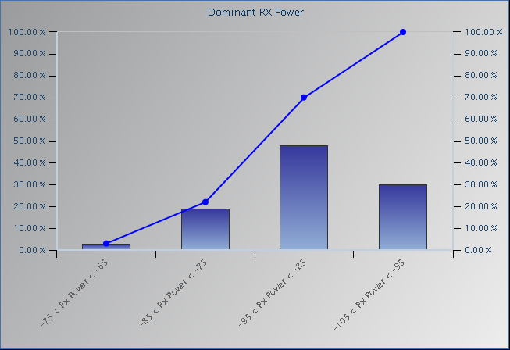
UMTS 850 Scan – UARFCN 4383 Io (RSSI) Histogram
RX Power
-140 to -105
-105 to -95
-95 to -85
-85 to -75
-75 to -65
-65 to -30
© 2015 AT&T Intellectual Property. All rights reserved. AT&T and the AT&T logo are trademarks of AT&T Intellectual Property.
AT&T Proprietary (Internal Use Only) Not for use or disclosure outside the AT&T companies except under written agreement

Slide 7
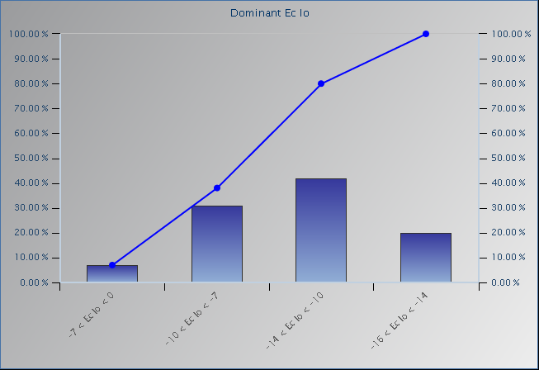
UMTS 850 Scan – UARFCN 4383 Ec/Io Histogram
Ec Io
-16 to -14
-14 to -10
-10 to -7
-7 to 0
0 to -16
© 2015 AT&T Intellectual Property. All rights reserved. AT&T and the AT&T logo are trademarks of AT&T Intellectual Property.
AT&T Proprietary (Internal Use Only) Not for use or disclosure outside the AT&T companies except under written agreement

Slide 8
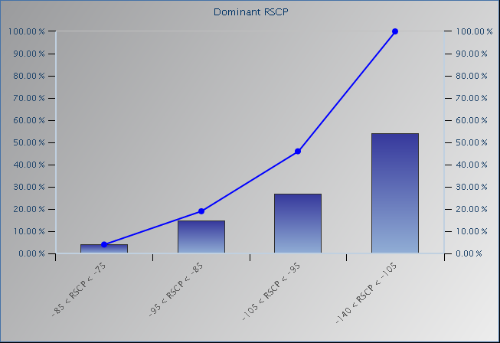
UMTS 850 Scan – UARFCN 4458 Ec (RSCP) Histogram
RSCP
-140 to -105
-105 to -95
-95 to -85
-85 to -75
-75 to -65
-65 to -30
© 2015 AT&T Intellectual Property. All rights reserved. AT&T and the AT&T logo are trademarks of AT&T Intellectual Property.
AT&T Proprietary (Internal Use Only) Not for use or disclosure outside the AT&T companies except under written agreement

Slide 9
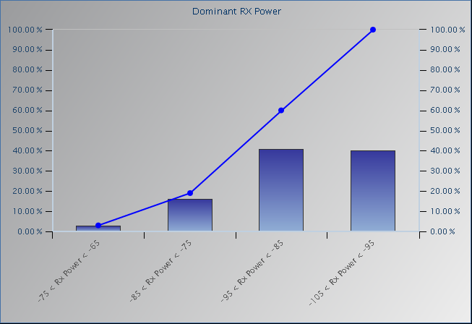
UMTS 850 Scan – UARFCN 4458 Io (RSSI) Histogram
RX Power
-140 to -105
-105 to -95
-95 to -85
-85 to -75
-75 to -65
-65 to -30
© 2015 AT&T Intellectual Property. All rights reserved. AT&T and the AT&T logo are trademarks of AT&T Intellectual Property.
AT&T Proprietary (Internal Use Only) Not for use or disclosure outside the AT&T companies except under written agreement

Slide 10
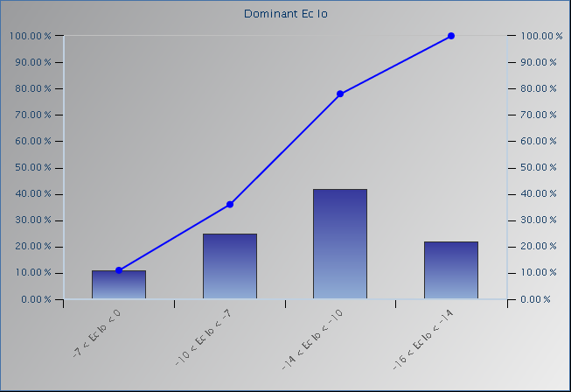
UMTS 850 Scan – UARFCN 4458 Ec/Io Histogram
Ec Io
-16 to -14
-14 to -10
-10 to -7
-7 to 0
0 to -16
© 2015 AT&T Intellectual Property. All rights reserved. AT&T and the AT&T logo are trademarks of AT&T Intellectual Property.
AT&T Proprietary (Internal Use Only) Not for use or disclosure outside the AT&T companies except under written agreement

Slide 11
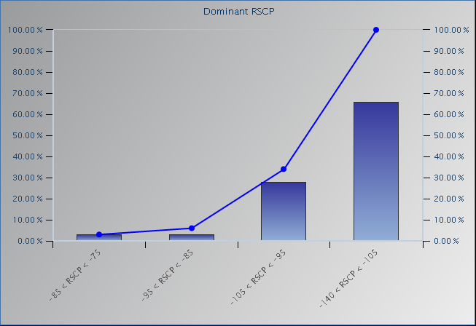
UMTS 1900 Scan – UARFCN 587 Ec (RSCP) Histogram
RSCP
-140 to -105
-105 to -95
-95 to -85
-85 to -75
-75 to -65
-65 to -30
© 2015 AT&T Intellectual Property. All rights reserved. AT&T and the AT&T logo are trademarks of AT&T Intellectual Property.
AT&T Proprietary (Internal Use Only) Not for use or disclosure outside the AT&T companies except under written agreement

Slide 12
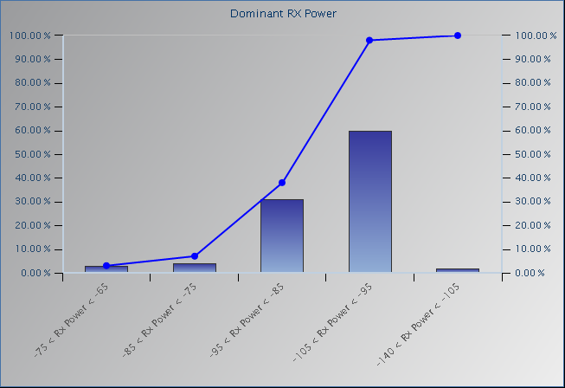
UMTS 1900 Scan – UARFCN 587 Io (RSSI) Histogram
RX Power
-140 to -105
-105 to -95
-95 to -85
-85 to -75
-75 to -65
-65 to -30
© 2015 AT&T Intellectual Property. All rights reserved. AT&T and the AT&T logo are trademarks of AT&T Intellectual Property.
AT&T Proprietary (Internal Use Only) Not for use or disclosure outside the AT&T companies except under written agreement

Slide 13
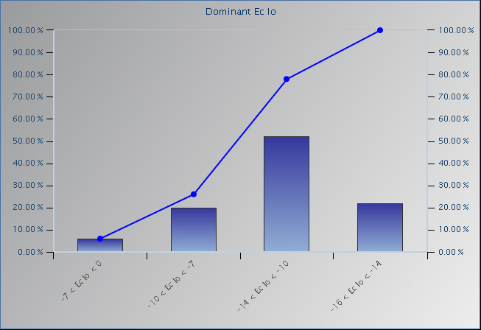
UMTS 1900 Scan – UARFCN 587 Ec/Io Histogram
Ec Io
-16 to -14
-14 to -10
-10 to -7
-7 to 0
0 to -16
© 2015 AT&T Intellectual Property. All rights reserved. AT&T and the AT&T logo are trademarks of AT&T Intellectual Property.
AT&T Proprietary (Internal Use Only) Not for use or disclosure outside the AT&T companies except under written agreement

Slide 14
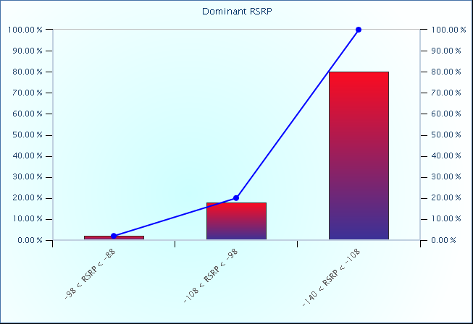
LTE 700 Scan – EARFCN 5780 RSRP Histogram
RSRP
-140 to -108
-108 to -98
-98 to -88
-88 to -78
-78 to -68
-68 to -30
© 2015 AT&T Intellectual Property. All rights reserved. AT&T and the AT&T logo are trademarks of AT&T Intellectual Property.
AT&T Proprietary (Internal Use Only) Not for use or disclosure outside the AT&T companies except under written agreement

Slide 15
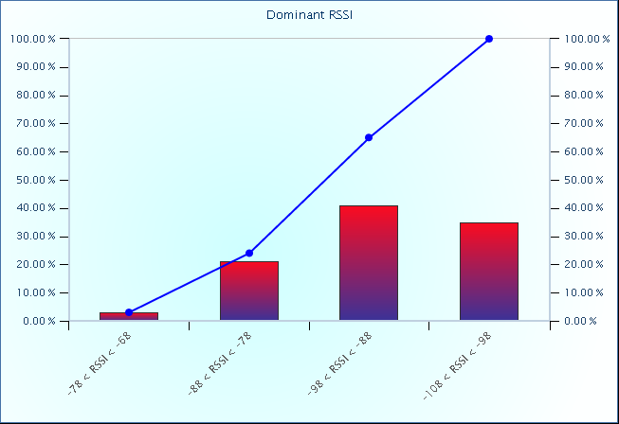
LTE 700 Scan – EARFCN 5780 RSSI Histogram
RSSI
-140 to -105
-105 to -95
-95 to -85
-85 to -75
-75 to -65
-65 to -30
© 2015 AT&T Intellectual Property. All rights reserved. AT&T and the AT&T logo are trademarks of AT&T Intellectual Property.
AT&T Proprietary (Internal Use Only) Not for use or disclosure outside the AT&T companies except under written agreement

Slide 16
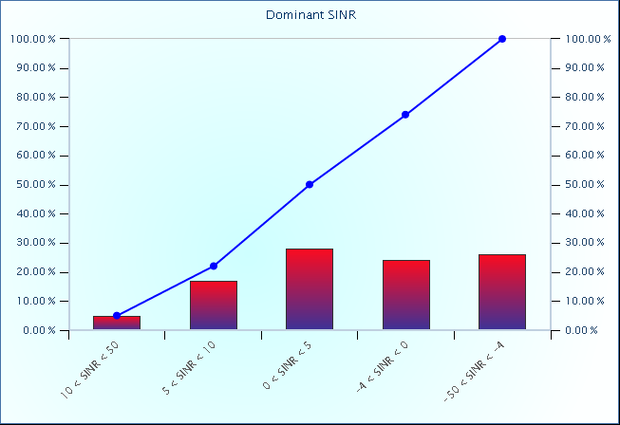
LTE 700 Scan – EARFCN 5780 SINR Histogram
SINR
-50 to -4
-4 to 0
0 to 5
5 to 10
10 to 50
© 2015 AT&T Intellectual Property. All rights reserved. AT&T and the AT&T logo are trademarks of AT&T Intellectual Property.
AT&T Proprietary (Internal Use Only) Not for use or disclosure outside the AT&T companies except under written agreement

Slide 17
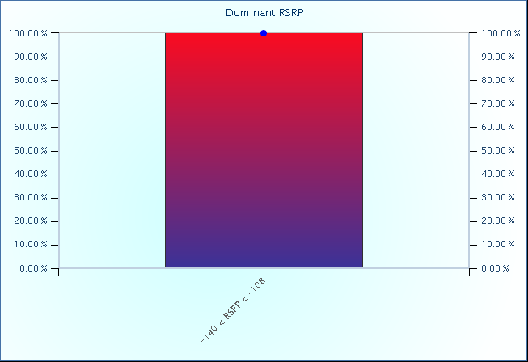
LTE 850 Scan – EARFCN 2576 RSRP Histogram
RSRP
-140 to -108
-108 to -98
-98 to -88
-88 to -78
-78 to -68
-68 to -30
© 2015 AT&T Intellectual Property. All rights reserved. AT&T and the AT&T logo are trademarks of AT&T Intellectual Property.
AT&T Proprietary (Internal Use Only) Not for use or disclosure outside the AT&T companies except under written agreement

Slide 18
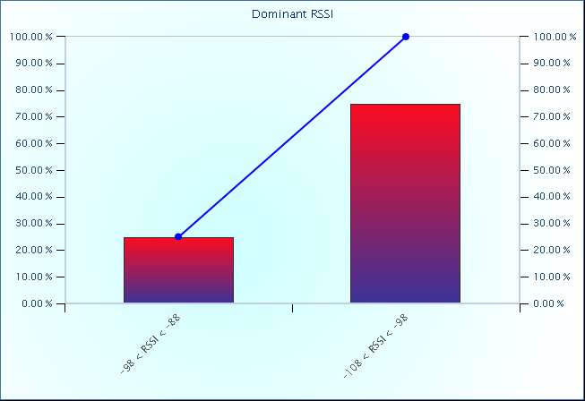
LTE 850 Scan – EARFCN 2576 RSSI Histogram
RSSI
-140 to -105
-105 to -95
-95 to -85
-85 to -75
-75 to -65
-65 to -30
© 2015 AT&T Intellectual Property. All rights reserved. AT&T and the AT&T logo are trademarks of AT&T Intellectual Property.
AT&T Proprietary (Internal Use Only) Not for use or disclosure outside the AT&T companies except under written agreement

Slide 19
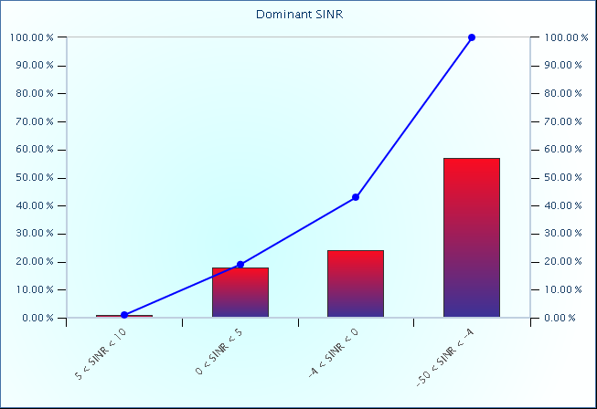
LTE 850 Scan – EARFCN 2576 SINR Histogram
SINR
-50 to -4
-4 to 0
0 to 5
5 to 10
10 to 50
© 2015 AT&T Intellectual Property. All rights reserved. AT&T and the AT&T logo are trademarks of AT&T Intellectual Property.
AT&T Proprietary (Internal Use Only) Not for use or disclosure outside the AT&T companies except under written agreement

Slide 20
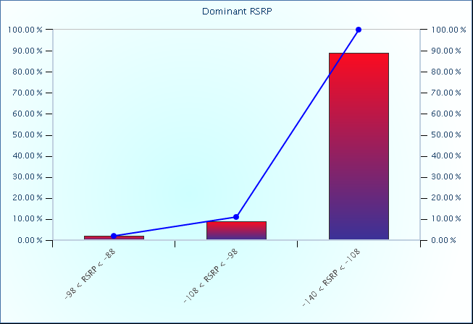
LTE 1900 Scan – EARFCN 1025 RSRP Histogram
RSRP
-140 to -108
-108 to -98
-98 to -88
-88 to -78
-78 to -68
-68 to -30
© 2015 AT&T Intellectual Property. All rights reserved. AT&T and the AT&T logo are trademarks of AT&T Intellectual Property.
AT&T Proprietary (Internal Use Only) Not for use or disclosure outside the AT&T companies except under written agreement

Slide 21
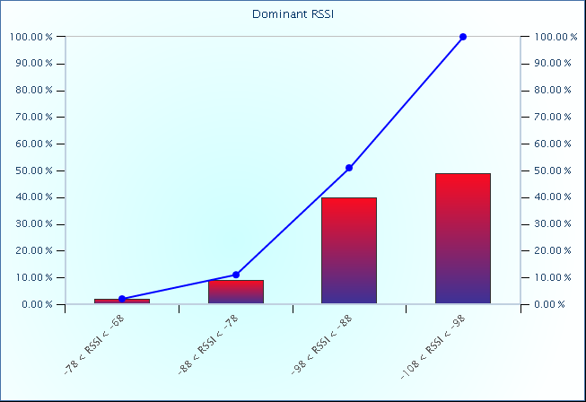
LTE 1900 Scan – EARFCN 1025 RSSI Histogram
RSSI
-140 to -105
-105 to -95
-95 to -85
-85 to -75
-75 to -65
-65 to -30
© 2015 AT&T Intellectual Property. All rights reserved. AT&T and the AT&T logo are trademarks of AT&T Intellectual Property.
AT&T Proprietary (Internal Use Only) Not for use or disclosure outside the AT&T companies except under written agreement

Slide 22
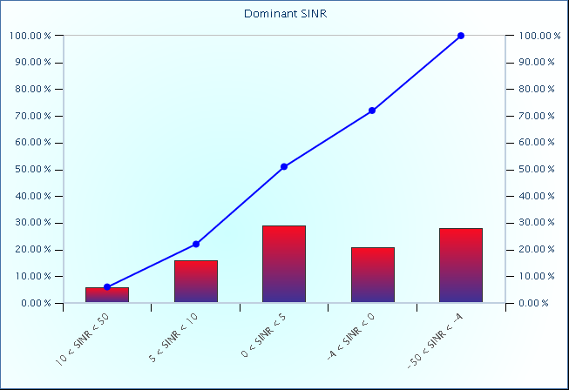
LTE 1900 Scan – EARFCN 1025 SINR Histogram
SINR
-50 to -4
-4 to 0
0 to 5
5 to 10
10 to 50
© 2015 AT&T Intellectual Property. All rights reserved. AT&T and the AT&T logo are trademarks of AT&T Intellectual Property.
AT&T Proprietary (Internal Use Only) Not for use or disclosure outside the AT&T companies except under written agreement

Slide 23
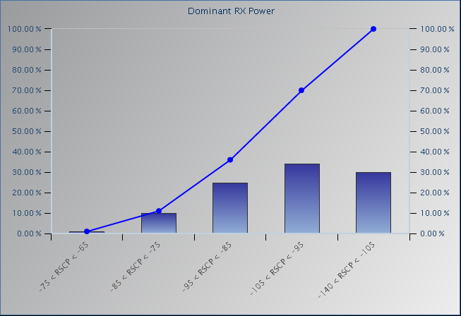
UMTS 850 Ue – UARFCN 4358 Ec (RSCP) Histogram
RX Power
-140 to -105
-105 to -95
-95 to -85
-85 to -75
-75 to -65
-65 to -30
© 2015 AT&T Intellectual Property. All rights reserved. AT&T and the AT&T logo are trademarks of AT&T Intellectual Property.
AT&T Proprietary (Internal Use Only) Not for use or disclosure outside the AT&T companies except under written agreement

Slide 24
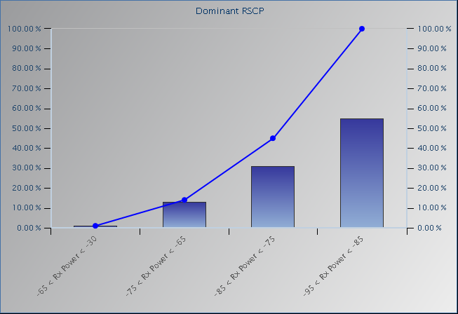
UMTS 850 Ue – UARFCN 4358 Io (RSSI) Histogram
RSCP
-140 to -105
-105 to -95
-95 to -85
-85 to -75
-75 to -65
-65 to -30
© 2015 AT&T Intellectual Property. All rights reserved. AT&T and the AT&T logo are trademarks of AT&T Intellectual Property.
AT&T Proprietary (Internal Use Only) Not for use or disclosure outside the AT&T companies except under written agreement

Slide 25
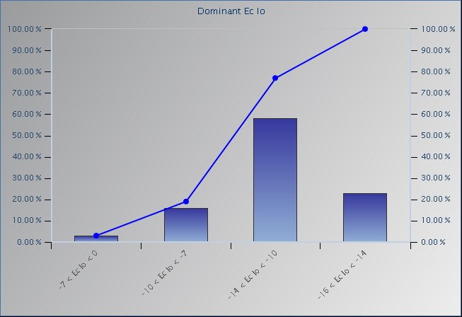
UMTS 850 Ue – UARFCN 4358 Ec/Io Histogram
Ec Io
-16 to -14
-14 to -10
-10 to -7
-7 to 0
0 to -16
© 2015 AT&T Intellectual Property. All rights reserved. AT&T and the AT&T logo are trademarks of AT&T Intellectual Property.
AT&T Proprietary (Internal Use Only) Not for use or disclosure outside the AT&T companies except under written agreement

Slide 26
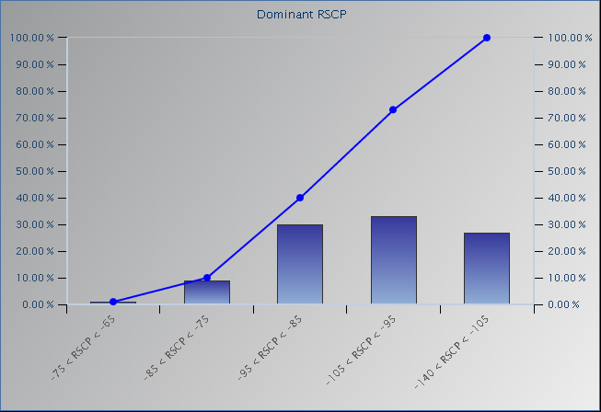
UMTS 850 Ue – UARFCN 4383 Ec (RSCP) Histogram
RSCP
-140 to -105
-105 to -95
-95 to -85
-85 to -75
-75 to -65
-65 to -30
© 2015 AT&T Intellectual Property. All rights reserved. AT&T and the AT&T logo are trademarks of AT&T Intellectual Property.
AT&T Proprietary (Internal Use Only) Not for use or disclosure outside the AT&T companies except under written agreement

Slide 27
UMTS 850 Ue – UARFCN 4383 Io (RSSI) Histogram
RX Power
-140 to -105
-105 to -95
-95 to -85
-85 to -75
-75 to -65
-65 to -30
© 2015 AT&T Intellectual Property. All rights reserved. AT&T and the AT&T logo are trademarks of AT&T Intellectual Property.
AT&T Proprietary (Internal Use Only) Not for use or disclosure outside the AT&T companies except under written agreement

Slide 28
UMTS 850 Ue – UARFCN 4383 Ec/Io Histogram
Ec Io
-16 to -14
-14 to -10
-10 to -7
-7 to 0
0 to -16
© 2015 AT&T Intellectual Property. All rights reserved. AT&T and the AT&T logo are trademarks of AT&T Intellectual Property.
AT&T Proprietary (Internal Use Only) Not for use or disclosure outside the AT&T companies except under written agreement

Slide 29
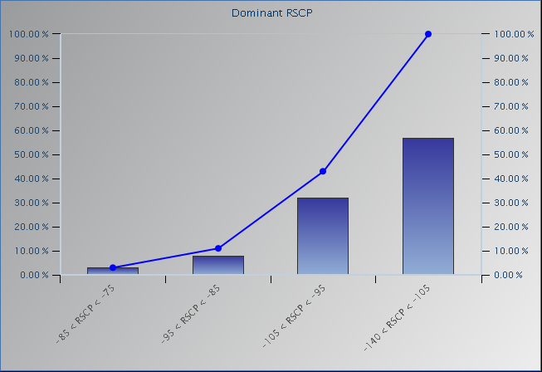
UMTS 850 Ue – UARFCN 4458 Ec (RSCP) Histogram
RSCP
-140 to -105
-105 to -95
-95 to -85
-85 to -75
-75 to -65
-65 to -30
© 2015 AT&T Intellectual Property. All rights reserved. AT&T and the AT&T logo are trademarks of AT&T Intellectual Property.
AT&T Proprietary (Internal Use Only) Not for use or disclosure outside the AT&T companies except under written agreement

Slide 30
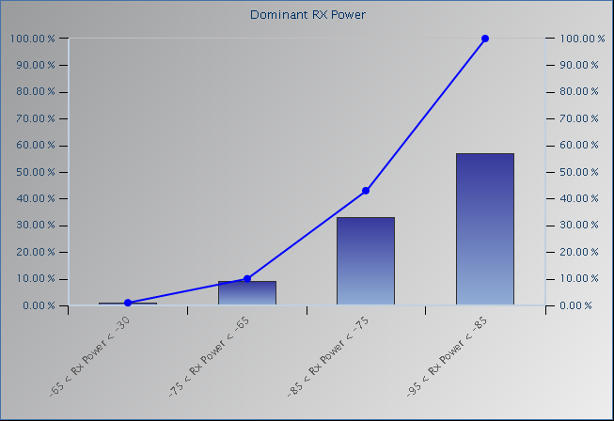
UMTS 850 Ue – UARFCN 4458 Io (RSSI) Histogram
RX Power
-140 to -105
-105 to -95
-95 to -85
-85 to -75
-75 to -65
-65 to -30
© 2015 AT&T Intellectual Property. All rights reserved. AT&T and the AT&T logo are trademarks of AT&T Intellectual Property.
AT&T Proprietary (Internal Use Only) Not for use or disclosure outside the AT&T companies except under written agreement

Slide 31
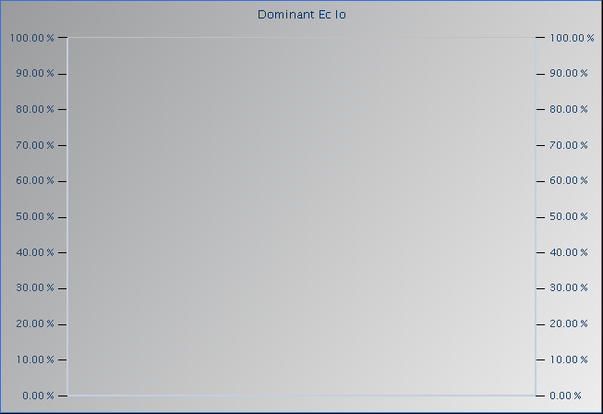
UMTS 850 Ue – UARFCN 4458 Ec/Io Histogram
Ec Io
-16 to -14
-14 to -10
-10 to -7
-7 to 0
0 to -16
© 2015 AT&T Intellectual Property. All rights reserved. AT&T and the AT&T logo are trademarks of AT&T Intellectual Property.
AT&T Proprietary (Internal Use Only) Not for use or disclosure outside the AT&T companies except under written agreement

Slide 32
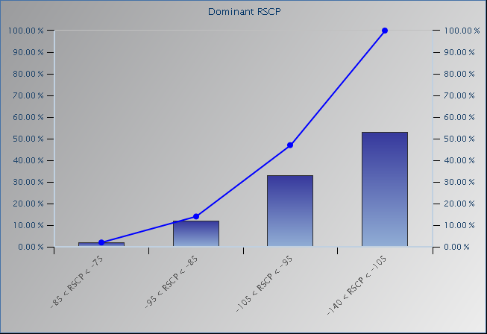
UMTS 1900 Ue – UARFCN 587 Ec (RSCP) Histogram
RSCP
-140 to -105
-105 to -95
-95 to -85
-85 to -75
-75 to -65
-65 to -30
© 2015 AT&T Intellectual Property. All rights reserved. AT&T and the AT&T logo are trademarks of AT&T Intellectual Property.
AT&T Proprietary (Internal Use Only) Not for use or disclosure outside the AT&T companies except under written agreement

Slide 33
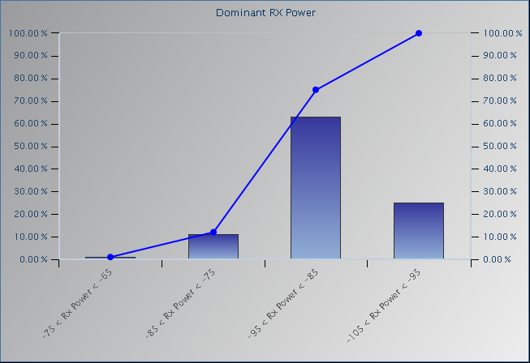
UMTS 1900 Ue – UARFCN 587 Io (RSSI) Histogram
RX Power
-140 to -105
-105 to -95
-95 to -85
-85 to -75
-75 to -65
-65 to -30
© 2015 AT&T Intellectual Property. All rights reserved. AT&T and the AT&T logo are trademarks of AT&T Intellectual Property.
AT&T Proprietary (Internal Use Only) Not for use or disclosure outside the AT&T companies except under written agreement

Slide 34
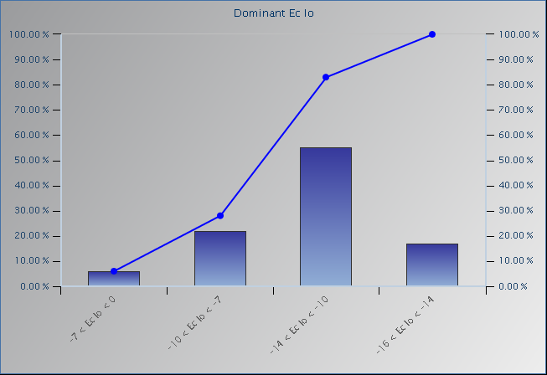
UMTS 1900 Ue – UARFCN 587 Ec/Io Histogram
Ec Io
-16 to -14
-14 to -10
-10 to -7
-7 to 0
0 to -16
© 2015 AT&T Intellectual Property. All rights reserved. AT&T and the AT&T logo are trademarks of AT&T Intellectual Property.
AT&T Proprietary (Internal Use Only) Not for use or disclosure outside the AT&T companies except under written agreement

Slide 35
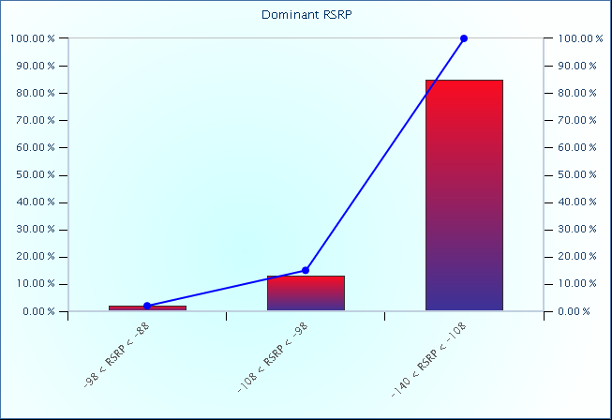
LTE 700 Ue – EARFCN 5780 RSRP Histogram
RSRP
-140 to -108
-108 to -98
-98 to -88
-88 to -78
-78 to -68
-68 to -30
© 2015 AT&T Intellectual Property. All rights reserved. AT&T and the AT&T logo are trademarks of AT&T Intellectual Property.
AT&T Proprietary (Internal Use Only) Not for use or disclosure outside the AT&T companies except under written agreement

Slide 36
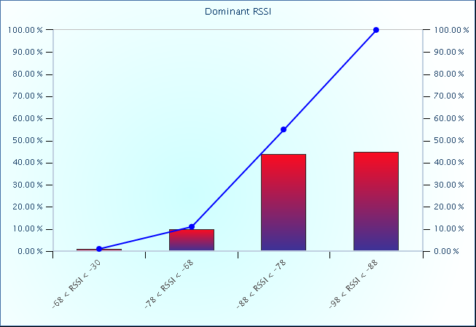
LTE 700 Ue – EARFCN 5780 RSSI Histogram
RSSI
-140 to -105
-105 to -95
-95 to -85
-85 to -75
-75 to -65
-65 to -30
© 2015 AT&T Intellectual Property. All rights reserved. AT&T and the AT&T logo are trademarks of AT&T Intellectual Property.
AT&T Proprietary (Internal Use Only) Not for use or disclosure outside the AT&T companies except under written agreement

Slide 37
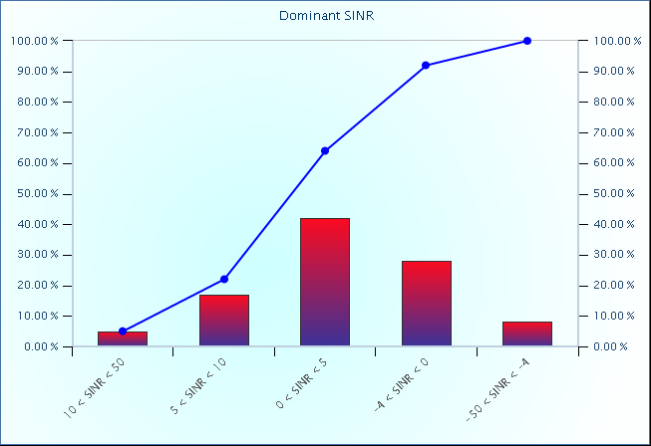
LTE 700 Ue – EARFCN 5780 SINR Histogram
SINR
-50 to -4
-4 to 0
0 to 5
5 to 10
10 to 50
© 2015 AT&T Intellectual Property. All rights reserved. AT&T and the AT&T logo are trademarks of AT&T Intellectual Property.
AT&T Proprietary (Internal Use Only) Not for use or disclosure outside the AT&T companies except under written agreement

Slide 38
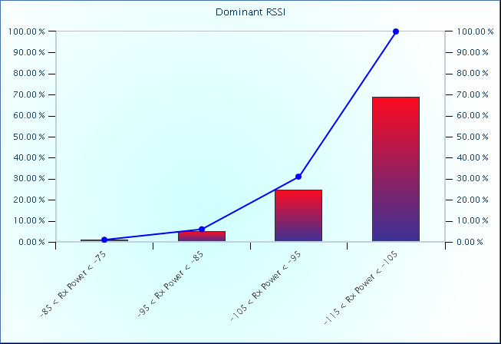
Femto Scan - Ch.612 RSRP Histogram
RSSI
-140 to -105
-105 to -95
-95 to -85
-85 to -75
-75 to -65
-65 to -30
© 2015 AT&T Intellectual Property. All rights reserved. AT&T and the AT&T logo are trademarks of AT&T Intellectual Property.
AT&T Proprietary (Internal Use Only) Not for use or disclosure outside the AT&T companies except under written agreement

